Slide 1

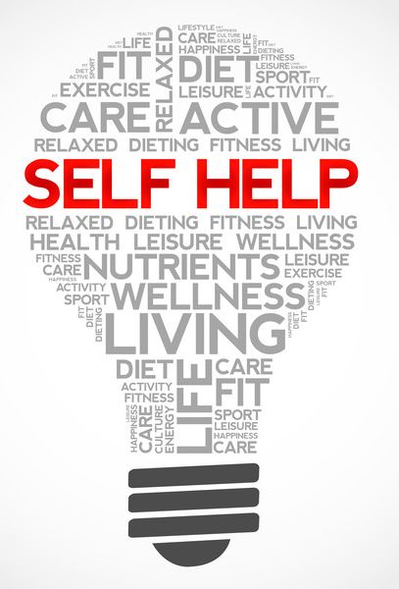
A PRESENTATION BY “ORBIT”

Slide 2
OUTLINE
ANAM MD ISFAQ
DIP FAZLA IMAM
RAHMAN MOHAIMENUR
SHIFA JANNATUN NUR
KANTA MARIA AKTER
Stay disciplined
Importance
Why should we ask for help?
Why does it matter?
Capable people for self-help
conclusion
How to overcome self-doubt
Qualities of good leaders
Making new habits
How to do self care

Slide 3
STAY DISCIPLINED
Start small.
Identify what you want to do differently.
Make a list.
Remember that failure is always part of success.

Slide 4
Qualities of good leaders
Responsibly and decision making
Initiative and creative ability
Emotional stability
Understanding the views of others

Slide 5
Making new habits
Make it tiny
Find a spot
Train the cycle

Slide 6
How to overcome self-doubt
Challenge bad thoughts about yourself
Take care of you
Take care of you
Help someone out
Surround yourself with people who make you feel good

Slide 7
How to do self care
Relaxation techniques
Controlling anxiety
Eliminate negativity
Becoming comfortable with your self

Slide 8
IMPORTANCE
It is important for us to cultivate the habit of self-help so that we can get our work done with our own efforts and resources.
It will build self-confidence and will enable us to achieve our goal.
We will be in total control our circumstances and situations.
The habit of self-help is immensely rewarding.

Slide 9
Why does it matter?
It is vital for us and we have to make a habit of self-help. It is the right need of life and we have to follow it always. If people do self-help then they get the vast feeling in their heart.

Slide 10
When should we ask for help?
We should ask for help from other people only when it is needed. We should try to do our jobs of our own. In the process, we should be ready to help ourselves in the best possible manner.

Slide 11
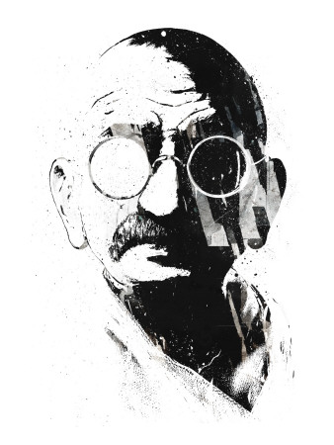
Capable People For Self-help
The self-help is the high and bright example as per the life of
Mahatma Gandhi. Gandhi always practiced what he
preached.
Some self-help activity of the Mahatma Gandhi:
He cleaned his room and spun his cloth.
He washed his clothes and cut his hair.
He took care of his goat

Slide 12
CONCLUSION
Self-help is the best help and therefore it should be
cultivated by everybody. It will not only make us smart and
active, but solve many of our problems automatically. Great men
in history have always preached self-help, because it is a quality
that makes a man great. One can become self-made only through self-help.
Children should be taught this by their parents and parent must practice it
before they teach.

Slide 13
THANK YOU

